Slide 1
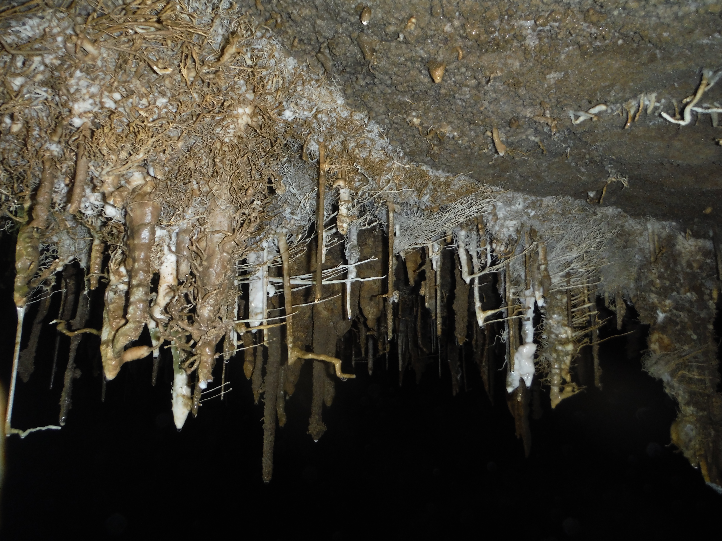
Cantabria 2026 1st to 14th August 2026 12 weeks away

Slide 2
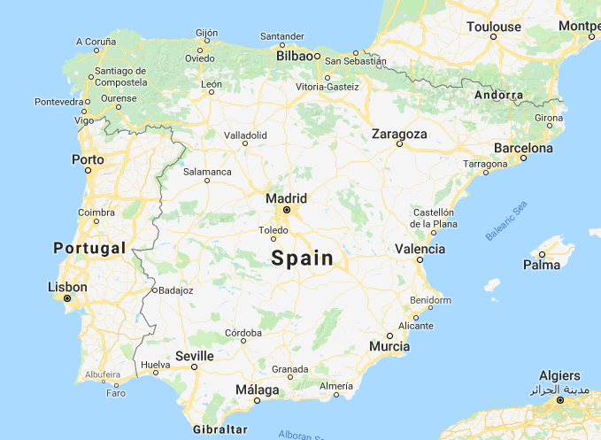
Where and how?

Slide 3
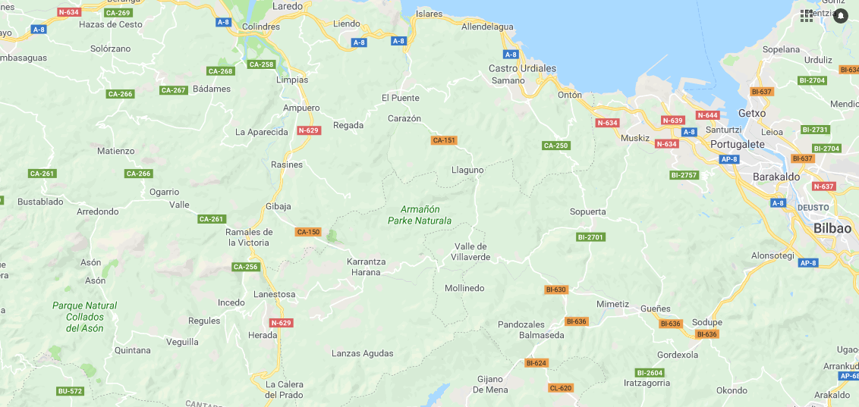
Where and how?

Slide 4
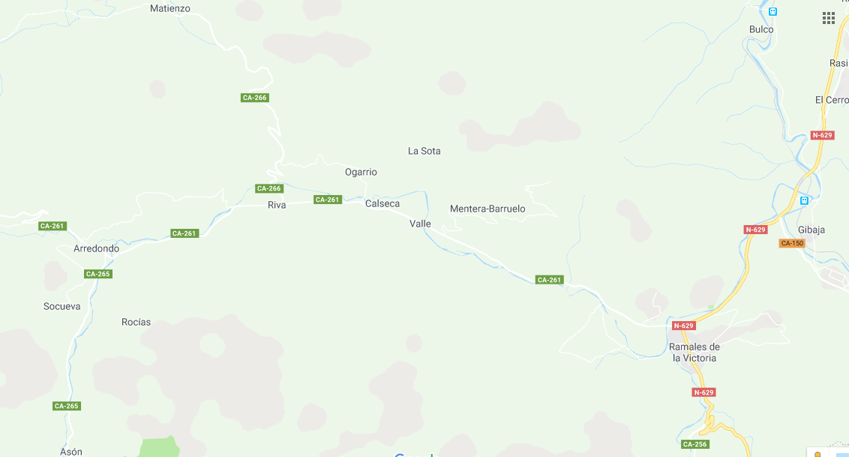
Where and how?

Slide 5
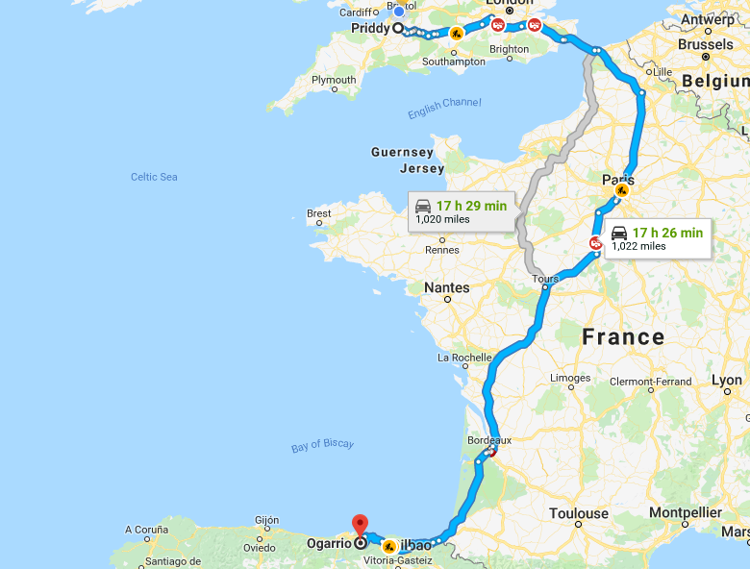
Where and how?
Ferry £1200+ (24H)
Other ports available
Plane £150+ (2H 30m)

Slide 6
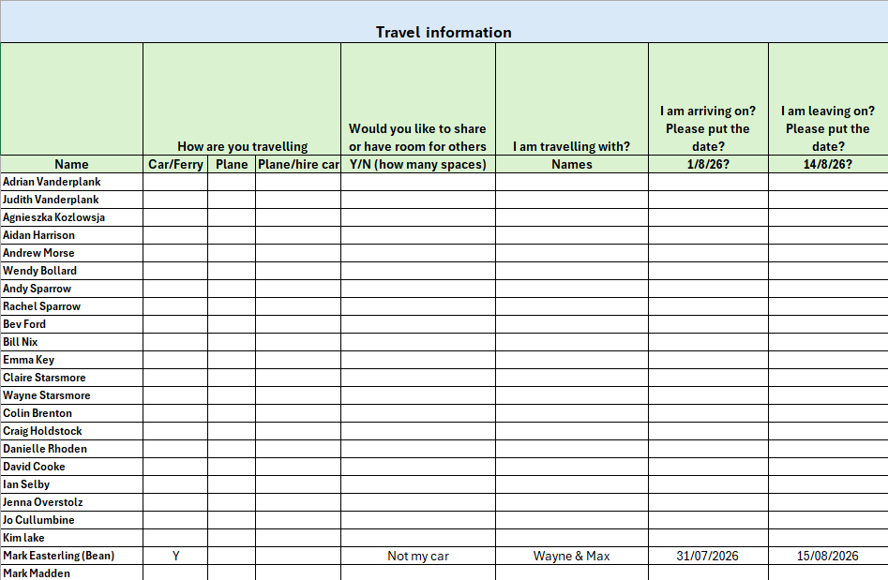
I will send this out ASAP for people to fill out. I will then share with you all.

Slide 7
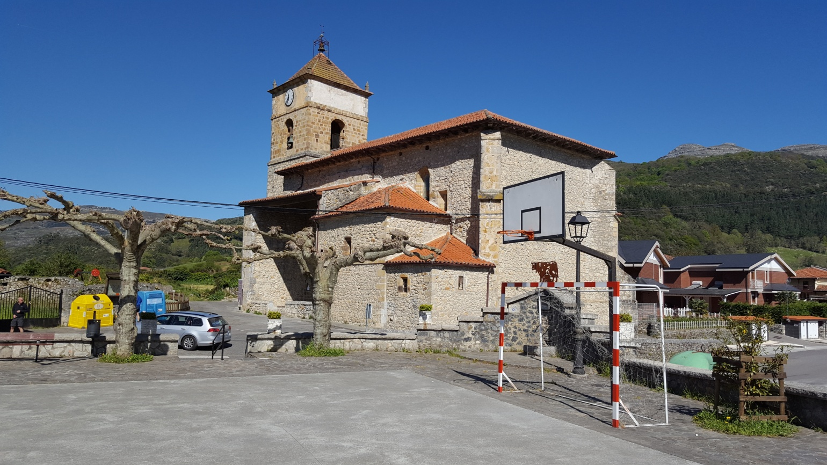

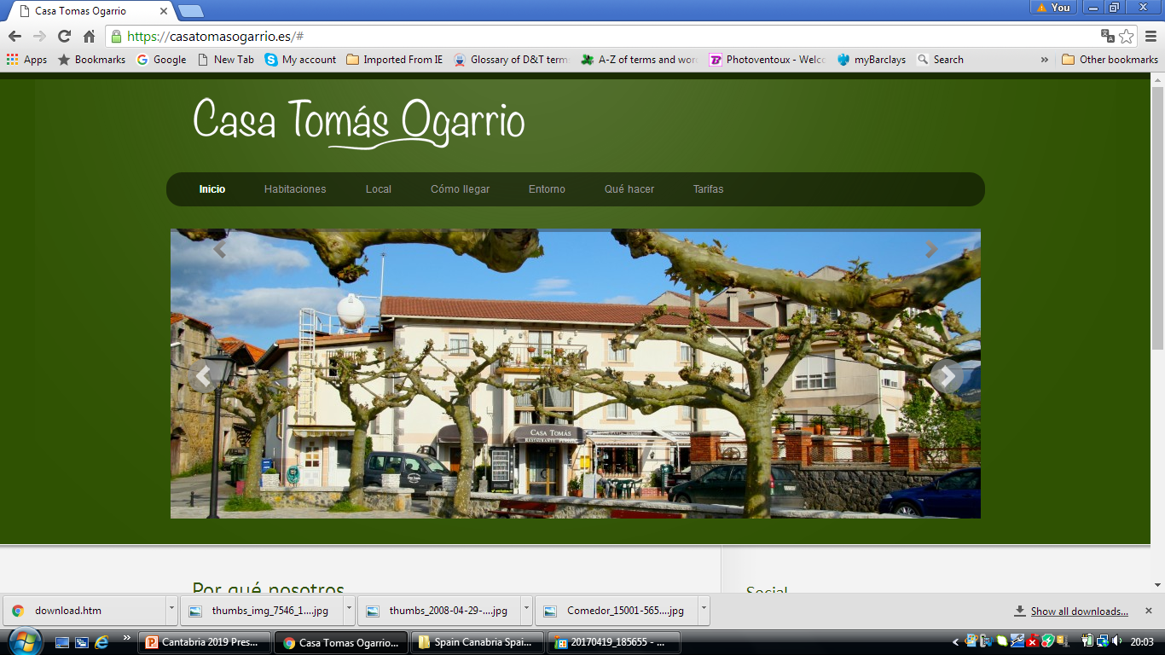
Accommodation
Total cost is £450? (£32?each night, 14 nights). This includes accommodation and evening meal. Their may be a fee for kit?(Yes)
Accommodation and evening meal are compulsory
Kit garage and Restaurant (BEER)

Slide 8

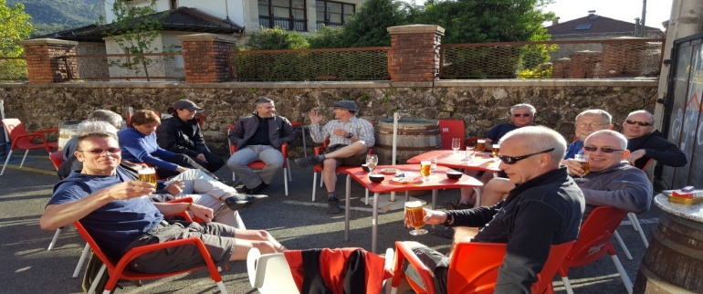
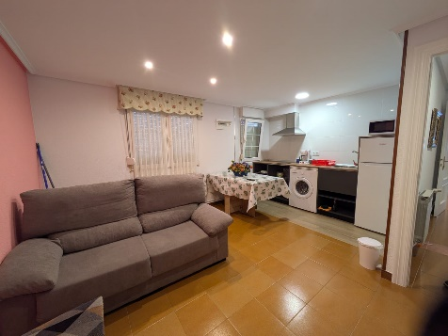
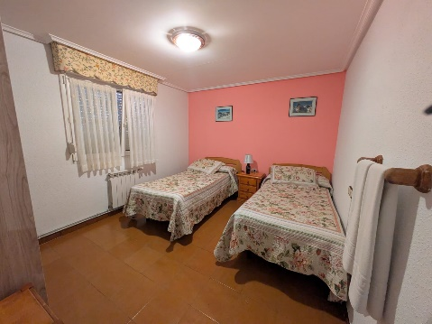
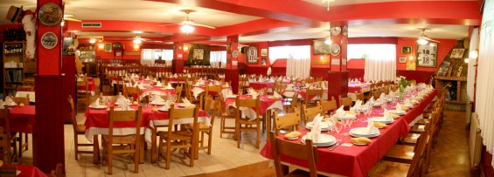
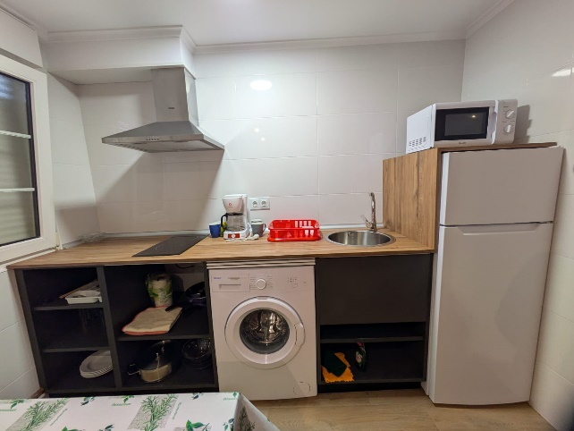
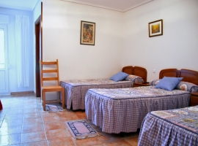
Accommodation
Each apartment/house: washing, machine, fridge, oven etc
5 apartments available
1: sleeps 4 persons, 2 beds in two rooms.
2: sleeps 4 persons, 2 beds in two rooms.
3: sleeps 6 persons, 3 beds in two rooms.
4: sleeps 4 persons, 2 beds in one room, 1 double bed in one room.
5: sleeps 4 persons, 2 beds in one room, 1 double bed in one room.
2 house: sleeps 12, 6 rooms, 2 beds in each room.
Rooms will be cleaned at the end of your stay by you!
All rooms include breakfast and dinner menu for 10 euros (3 course menu)

Slide 9
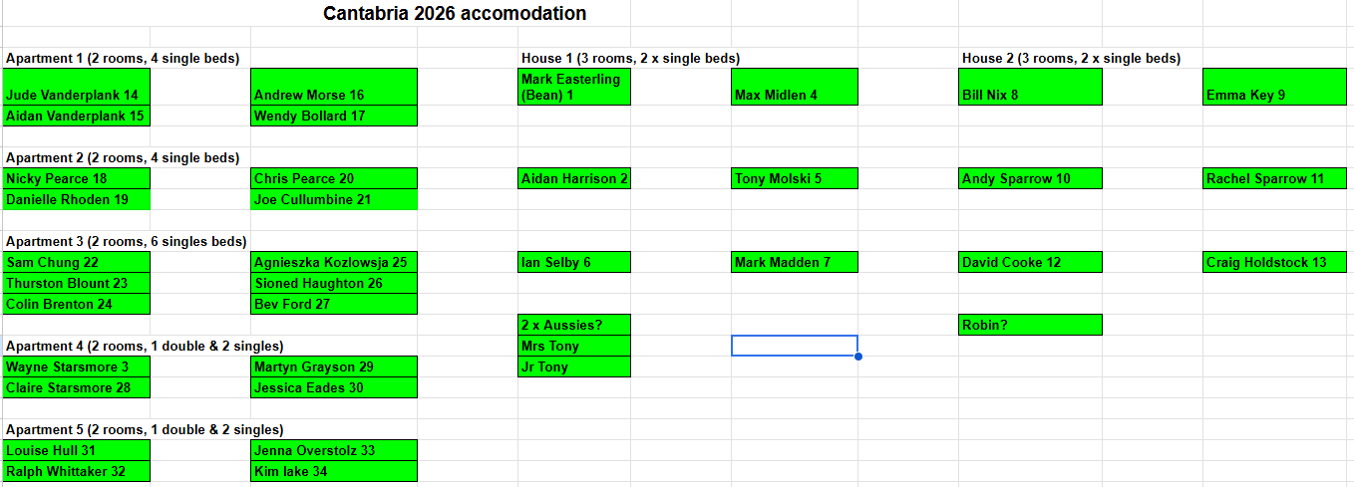
Rooms I can change beds/rooms if you must?

Slide 10
Bar Tomas
Food:
All allergies are catered for as food will be a buffet of hot and cold food. Dinner will be at 19.00H each night. Any problems please see me!
If you are still underground, we can arrange a takeaway!
Bar:
Each person will have a tag, show the tag when you order at the bar. You will pay your bill when you leave!
Please only consume bought drinks at the Bar/Terrace/Restaurant
Drinks are cheap & they are doing us a huge favour!
Garage:
Garage space for caving kit and equipment. Also, a drying line and washdown area.
Tip:
We will gather a tip for Bar Tomas at the end 20/30 euros each?

Slide 11
Caving Lots of caves to suit all abilities (SRT would be an advantage).
Through trips:
Cueto – Coventosa (First 300m will be hard rigged)
Tibia – Fresca
Los Humos – Canuela
Tonio – Canuela (Most visited cave in Spain)
Red del Silencio
Sistema rio Munio
Sistema Cueva del Lobo
Solviejo – Torca del Rayo de Sol
Narizon – Palomas
Ojancano – Anjana (Bus stop cave)
Sel de Haya – Cobijon (A few hours away)
Torca la Sima – Gandara (Will be hard rigged during our stay)
Caligafos – Gandara (Big through trip) (Angel pitch will be rigged allowing trips into Gandara)
Acebo – Mortero
Cuivo – Mortero
Rubicera – Mortero
Moertero del Crucero – La Calaca – Mazo Chico
Garma Ciego to Sumidero de Cellagua (Needs to be booked in advance)
Non through trips:
Coventosa
Gandara
Canuela
Cuevamur
Gandara (Angel pitch will be rigged allowing trips into Gandara)
Cueve de la carrera
Lots of caves also in Matienzo but who wants to go there?
Cantabria cave link below!
https://docs.google.com/spreadsheets/d/1l5eDtJOJJbt7h9zbmtKBLyv0wUcQ2IbqWt_j26ZYlXE/edit?usp=sharing

Slide 12
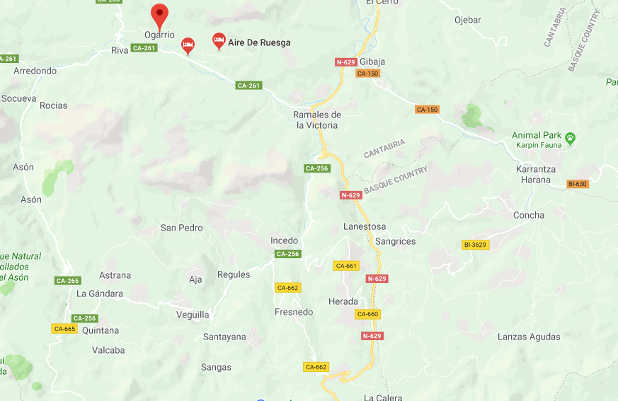
Caving Lots of caves to suit all abilities (SRT would be an advantage)
Red del Silencio
Cueto -Coventosa
Cuevamur
Tibia Fresca
Mortero
Gandara

Slide 13
Cueto - Coventosa
It’s the most classic of all the through trips located in Asón valley. It’s really interesting not only for the altitude difference between the entrances (695m) and it’s long distance (more than 6km) but also for the variety of the technical difficulties that it involves, as the huge 300m entrance pitch rigged for pull through technique, the long series of pitches that sometimes involve pendulums and that reach a depth of -581m and the squeezes in the intermediate net of passages. All this unite with the big attractive galleries and lakes makes Cueto Coventosa a great trip.
9 to 16 hour through trip if entrance is pre-rigged
If doing a pull-through 18 hours +

Slide 14
Cueto - Coventosa

Slide 15
Red del Silencio
Actually the system of the Rio Silencio has six entrances, Torca de Caballos(Hoyon), Torca de Seguia, Sima-Cueva del Escobal, Torca del Hoyu Jondo, Torca de la Canal and Cueva del Valle. The traverses described here consist of entering Caballos and exiting Valle or canal or entering Canal and exiting Valle.
The last entrance discovered in the system is the Torca de Seguias (very close to Caballos but in the southern slope in the direction of Ranero) Taking advantage of the pronounced low water level in recent years the explorers achieved penetration after making some deconstruction towards a zone of inaccessible crawls that finally connected with the system via a network of tubes at the start of the meander of Caballos. In this form the resulting traverse continues increasing enormously the development of the system (one of the longest in the world) although the extreme toughness of the tubes linking from Seguia reduces the attraction.
8 to 16 hour through trip (pull through technique)

Slide 16
Red del Silencio

Slide 17
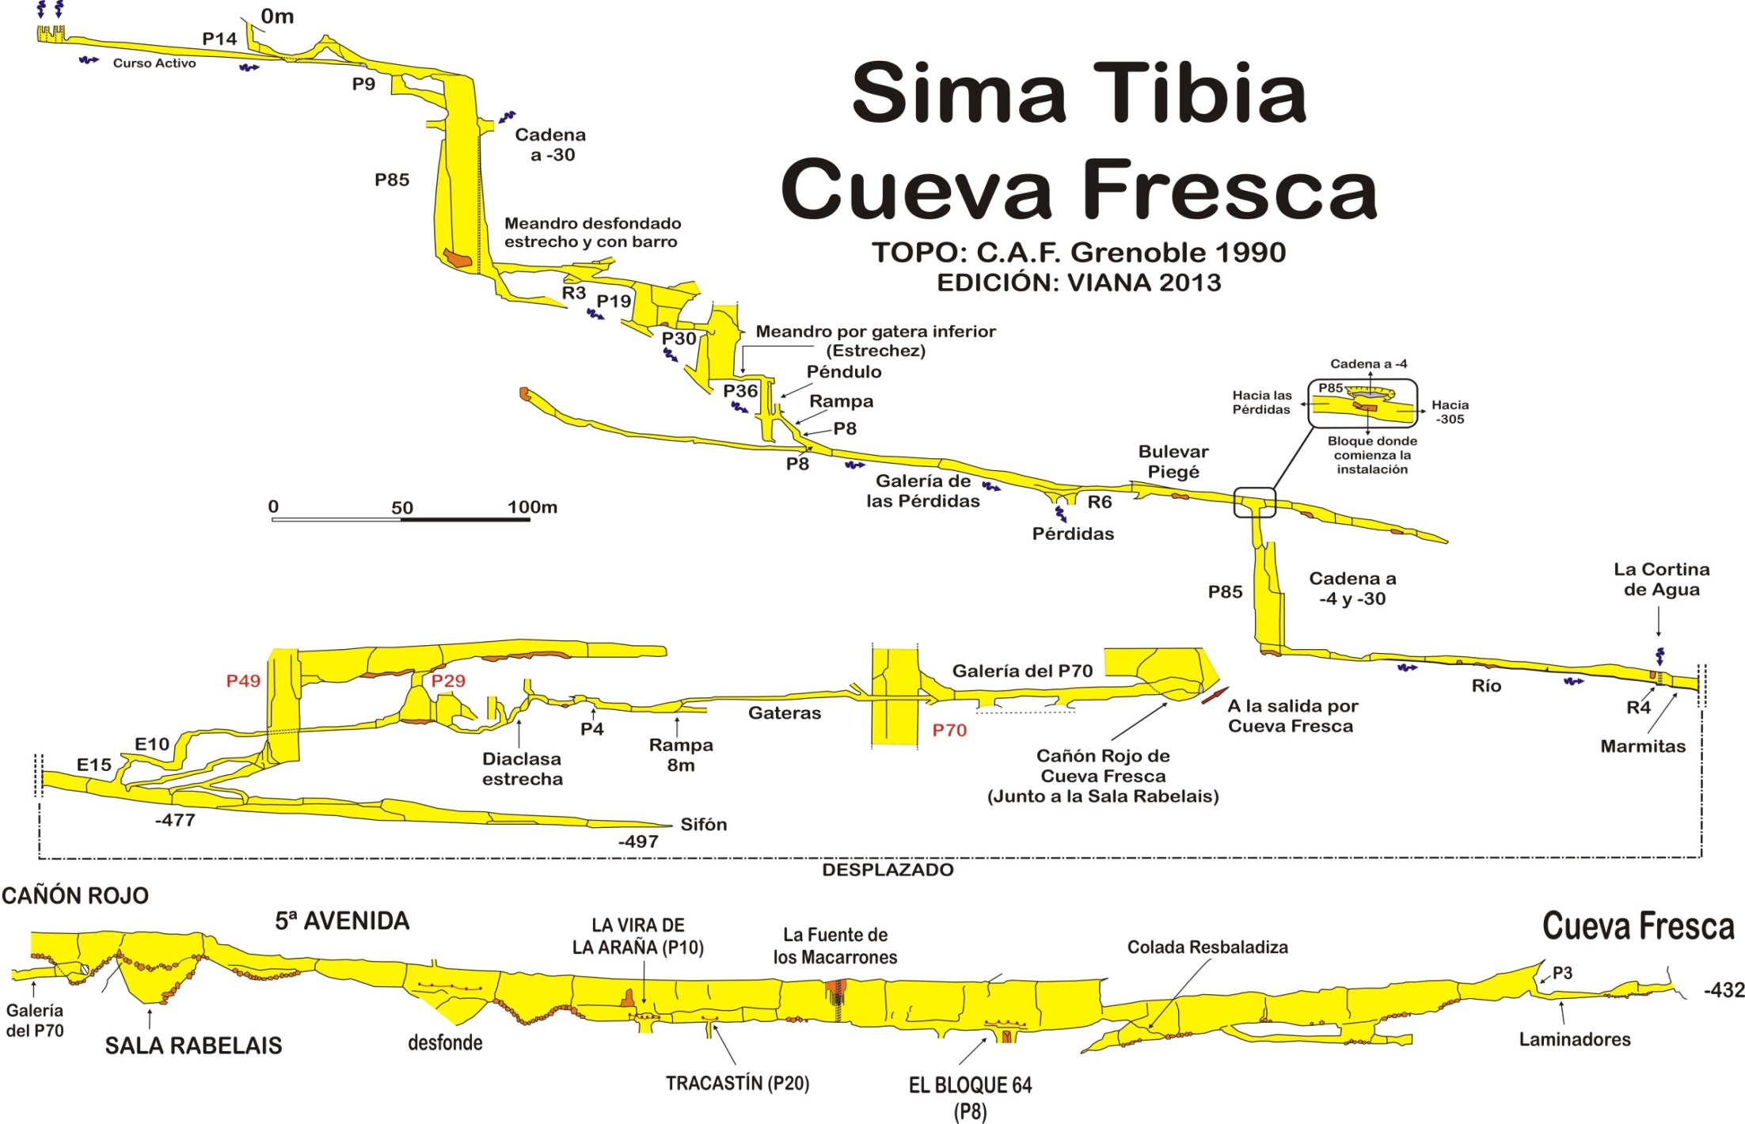
8 to 16 hour through trip (pull through technique)

Slide 18
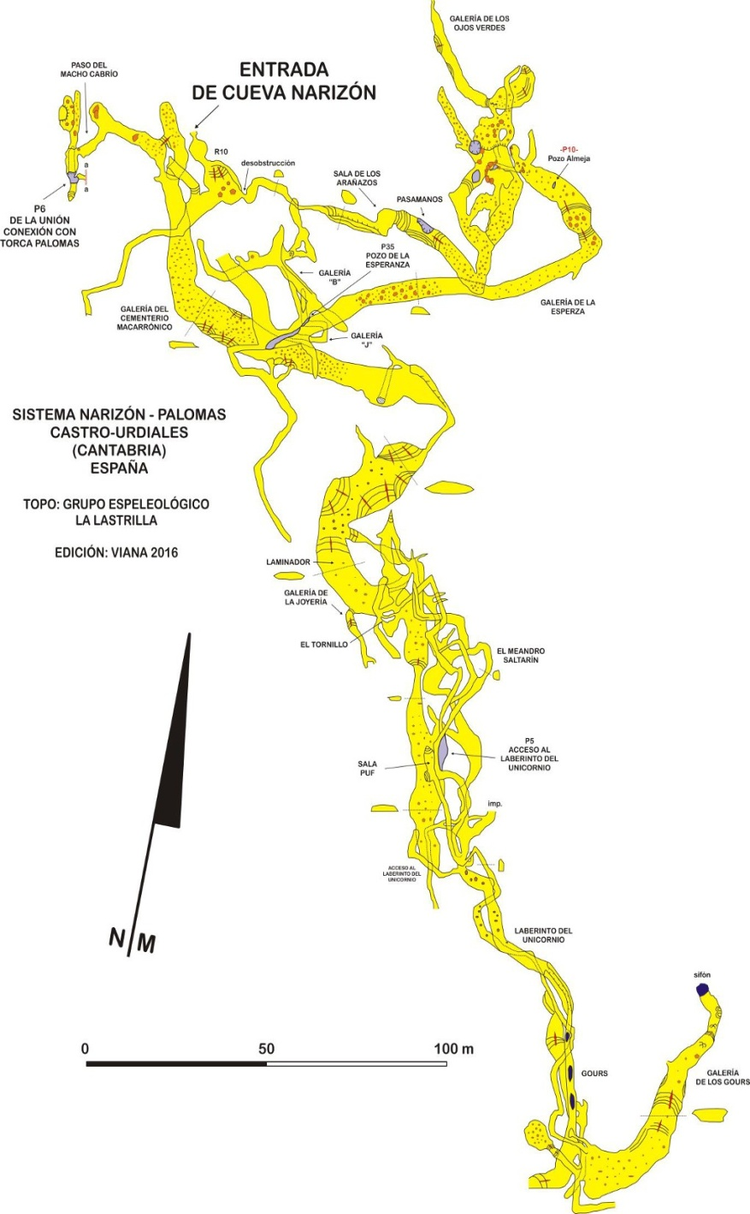
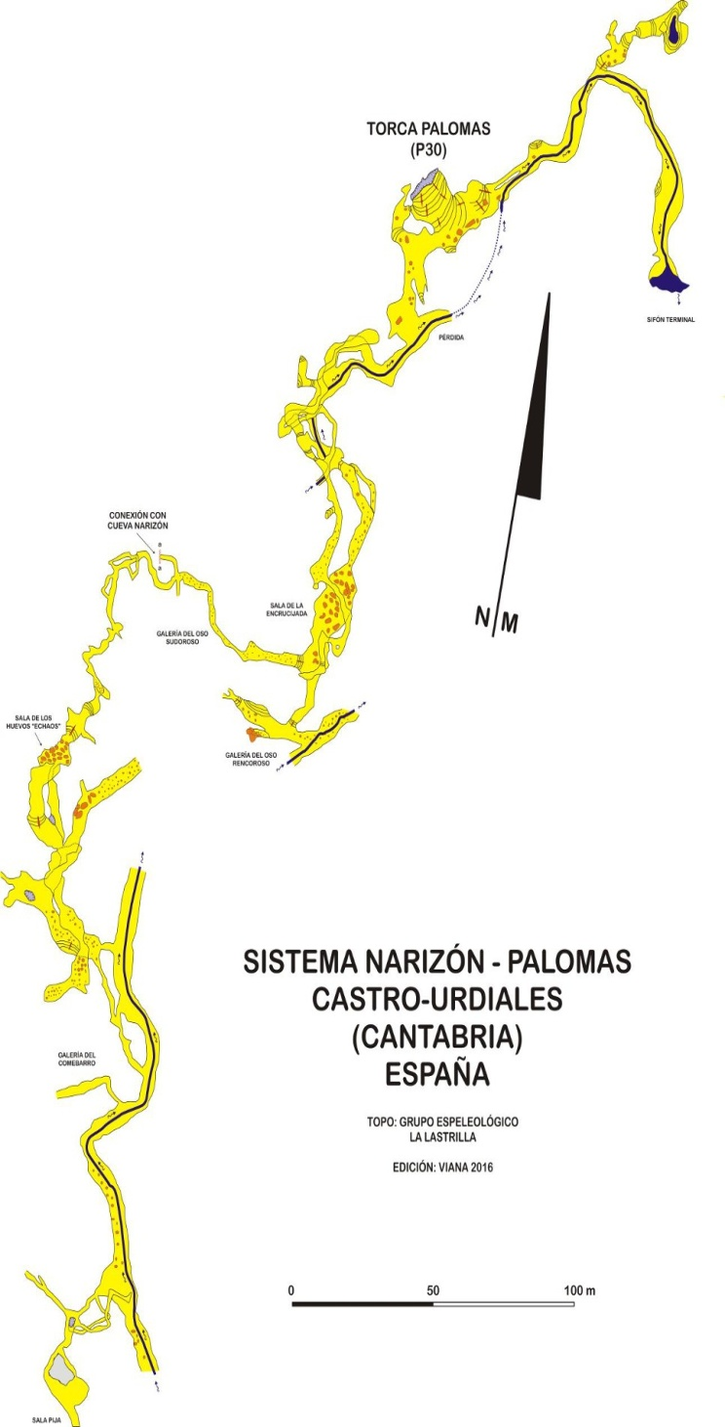
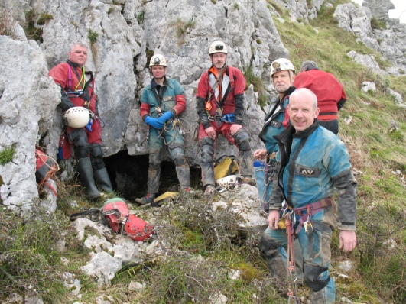
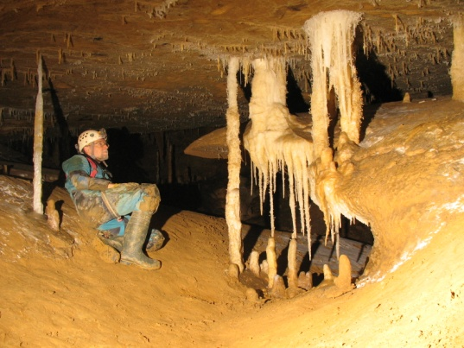
Narizon
4 + hour through trip (Simple SRT trip)

Slide 19
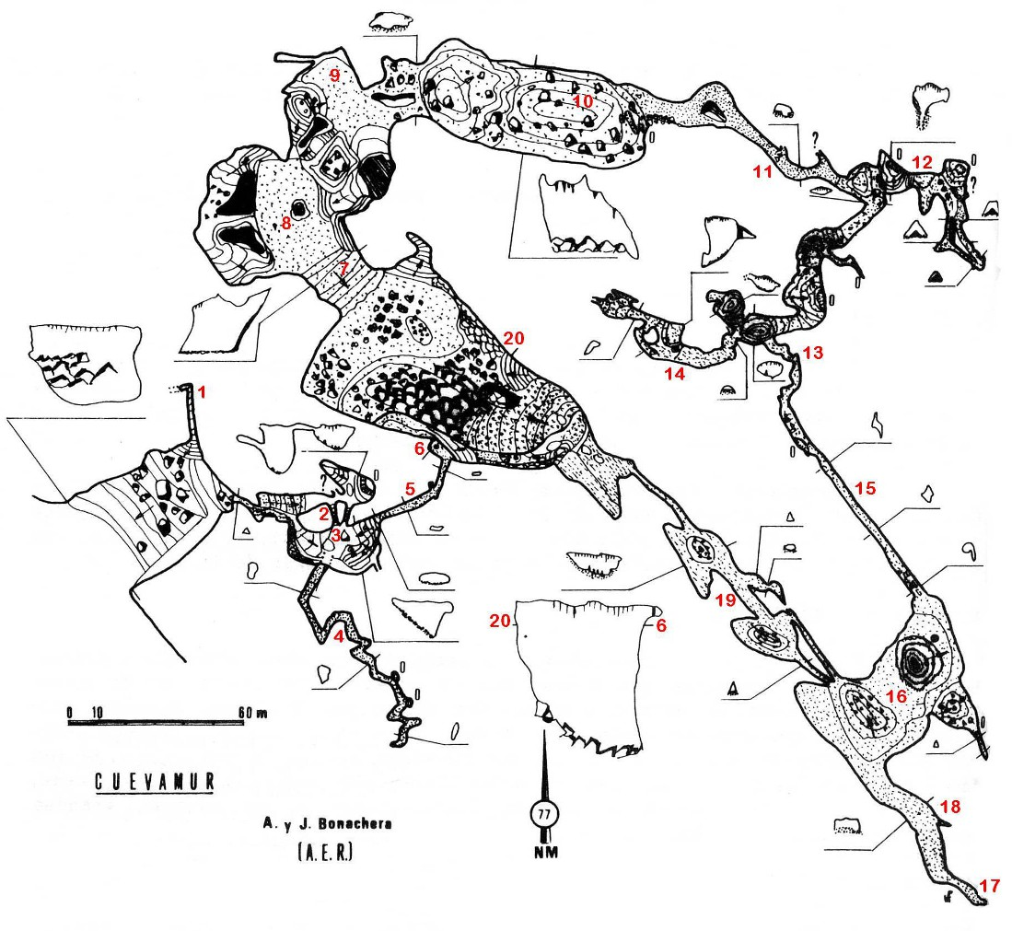
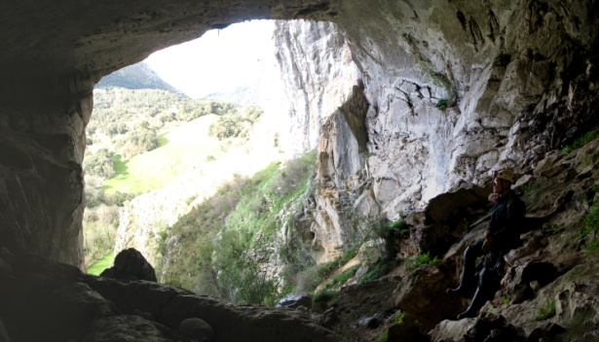
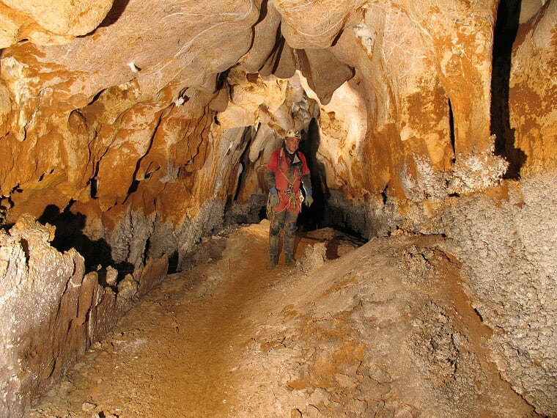
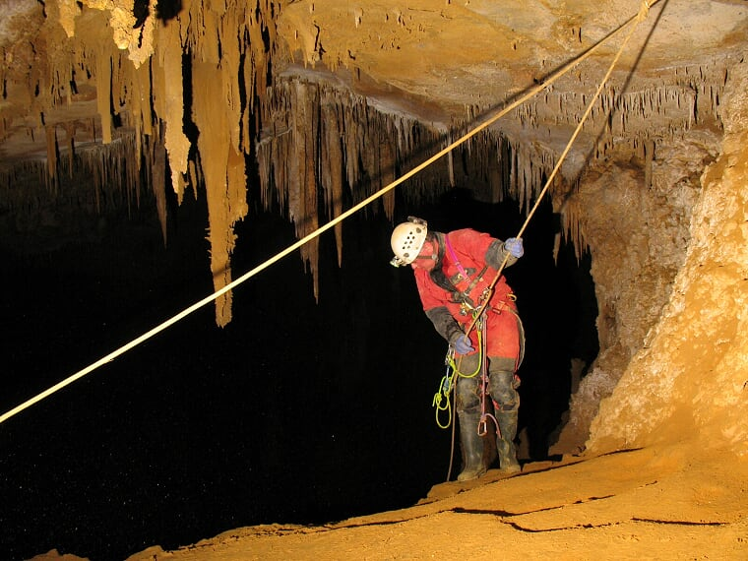
Cuevamur
4+ hours (Simple SRT trip)

Slide 20
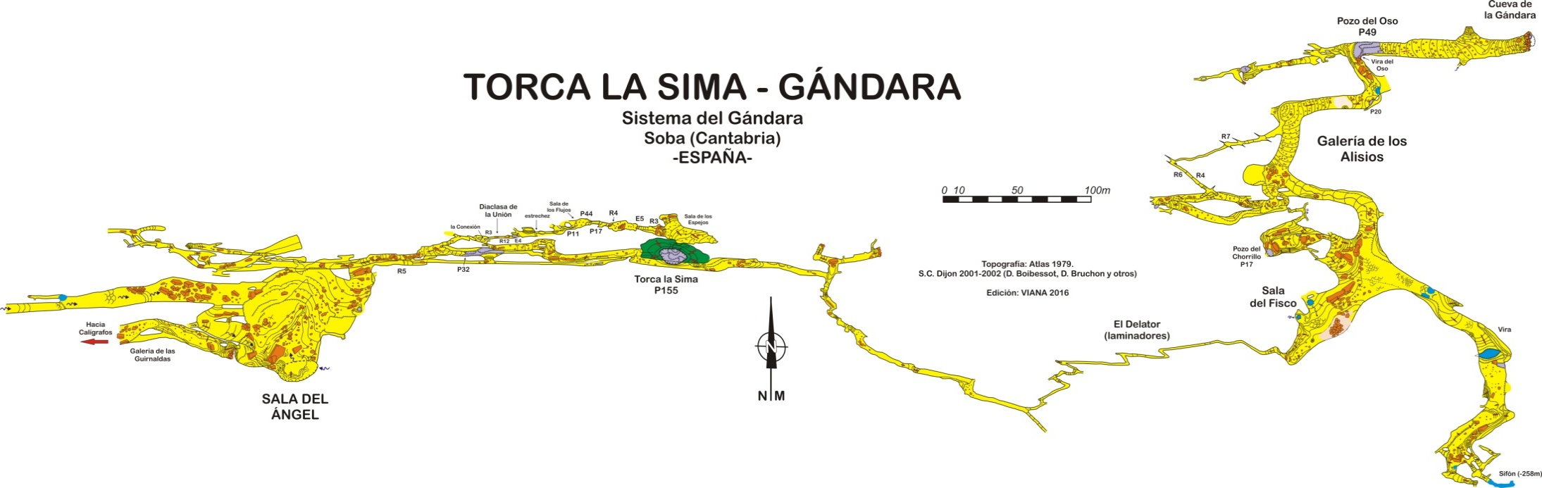
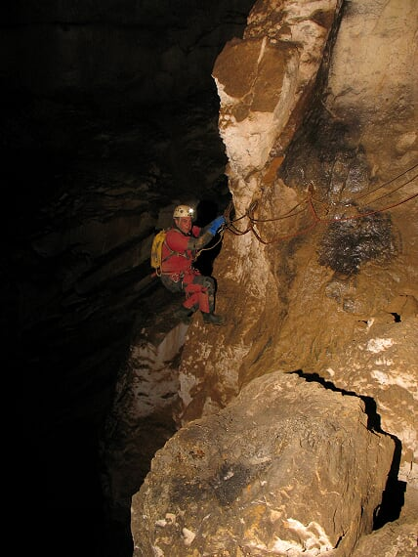
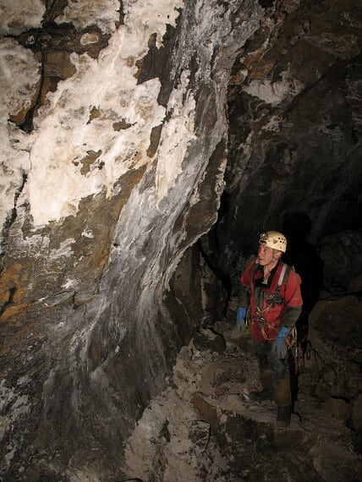
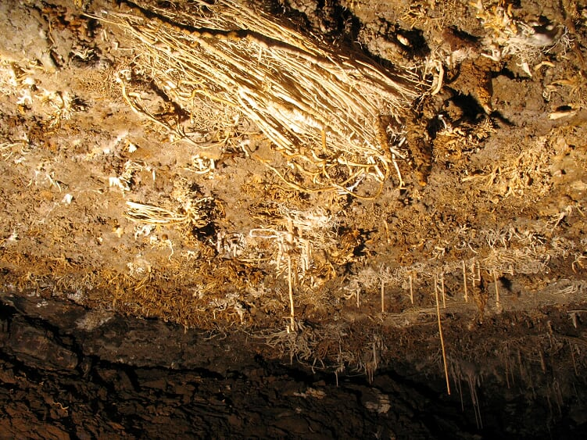
Gandara
Range of trips in Gandara from a few hours too 18 hours +

Slide 21
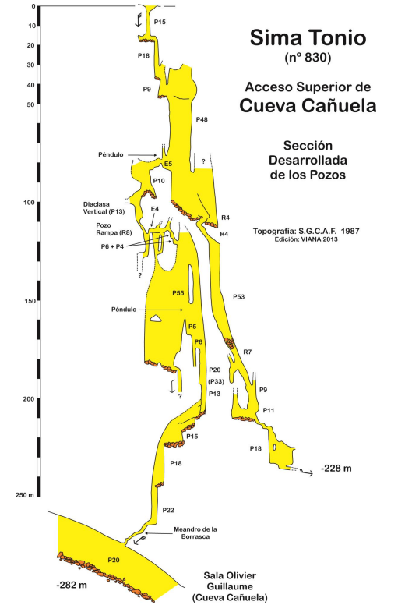
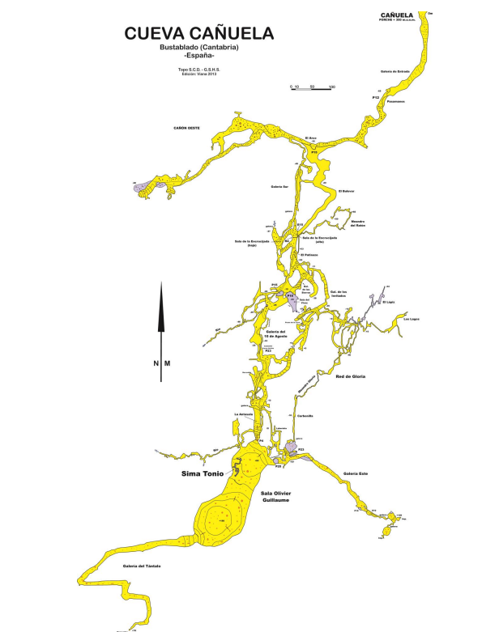
6 to 10 hour through trip (pull through technique)
Can go in bottom and avoid pitches.

Slide 22
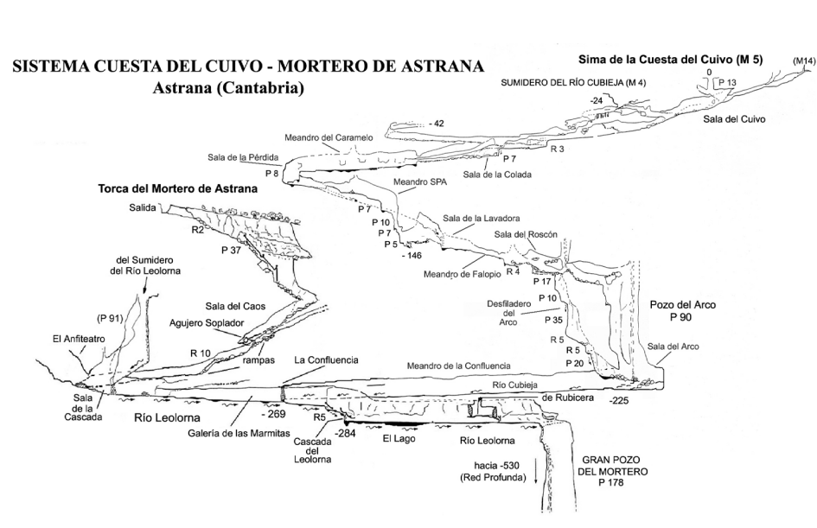
4 to 8 hour through trip (pull through technique)
Can go in Mortero (this is always rigged

Slide 23
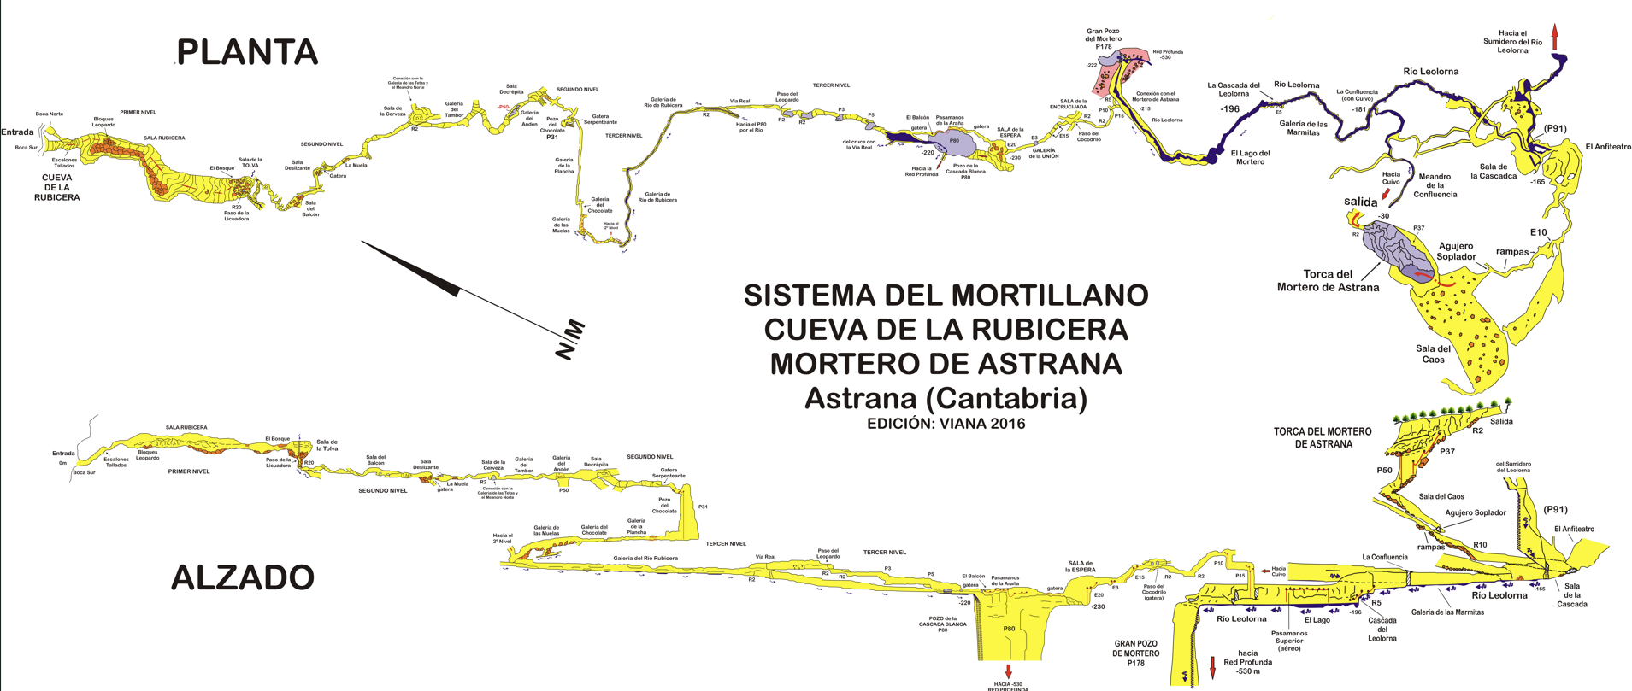
8 to 15 hour through trip (pull through technique)
Can go in Mortero (this is always rigged

Slide 24
Caving Lots of caves to suit all abilities (SRT is a must)
Cueto will be hard rigged for the first 300m (entrance pitch). Then pull through the rest of the cave.
Entrance to Coventosa will be rigged.
Boats will be installed on the 3 lakes in Coventosa (2 x boats each lake).
The Angle pitch in Gandara will be rigged to allow through trips from Caligafos or exploring the Gandara system.
We will hard rigg Torca la Sima to allow through trips in both directions.
Garma Ciego to Sumidero de Cellagua (Needs to be booked in advance). I suggest who ever wants to do this trip we book it on 10th of August? (see link attached)
https://espeleosocorro.es/informacion-campamento-garma-ciega/
Registration form for Garma Ciego to Sumidero de Cellagua
https://docs.google.com/forms/d/e/1FAIpQLSdPy9K7vOrkilYpSpA-jDgviUNIhq0zMlT3bIGYX2jeArcrsQ/viewform
Payment of 25 euros paid:
Or by transfer to our TRIODOS account:
ES04 1491 0001 2421 4922 4327
All other trips that require rigging/rope we be available
We are going to charge £20 towards caving equipment please
You must have insurance to cave
https://docs.google.com/forms/d/e/1FAIpQLSfbOi_eaEywWvhIUDXAWnoJldSUg9KcfoDQgZ6T2WhZNXeVyg/viewform?usp=sharing&ouid=108519175096752440361

Slide 25
You need to phone the police before every caving trip! 112

Slide 26
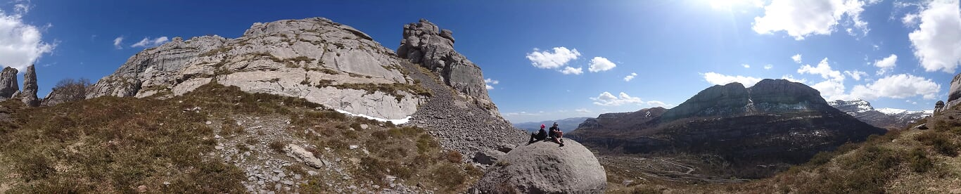
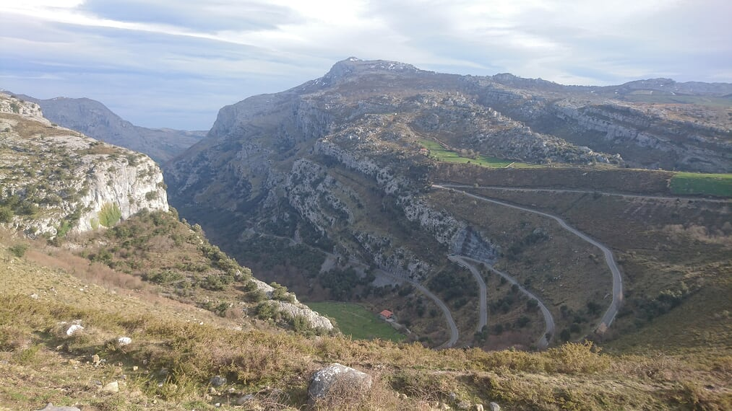
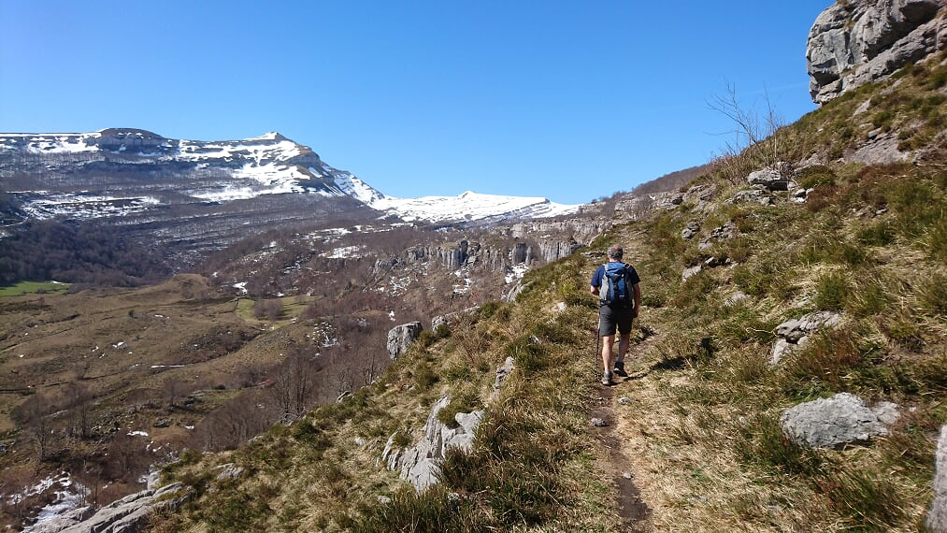
Walking/Via Ferrata/Cycling/Seaside
Cannoning in Spain:
https://infobarrancos.es/app.php/mapa-barrancos

Slide 27
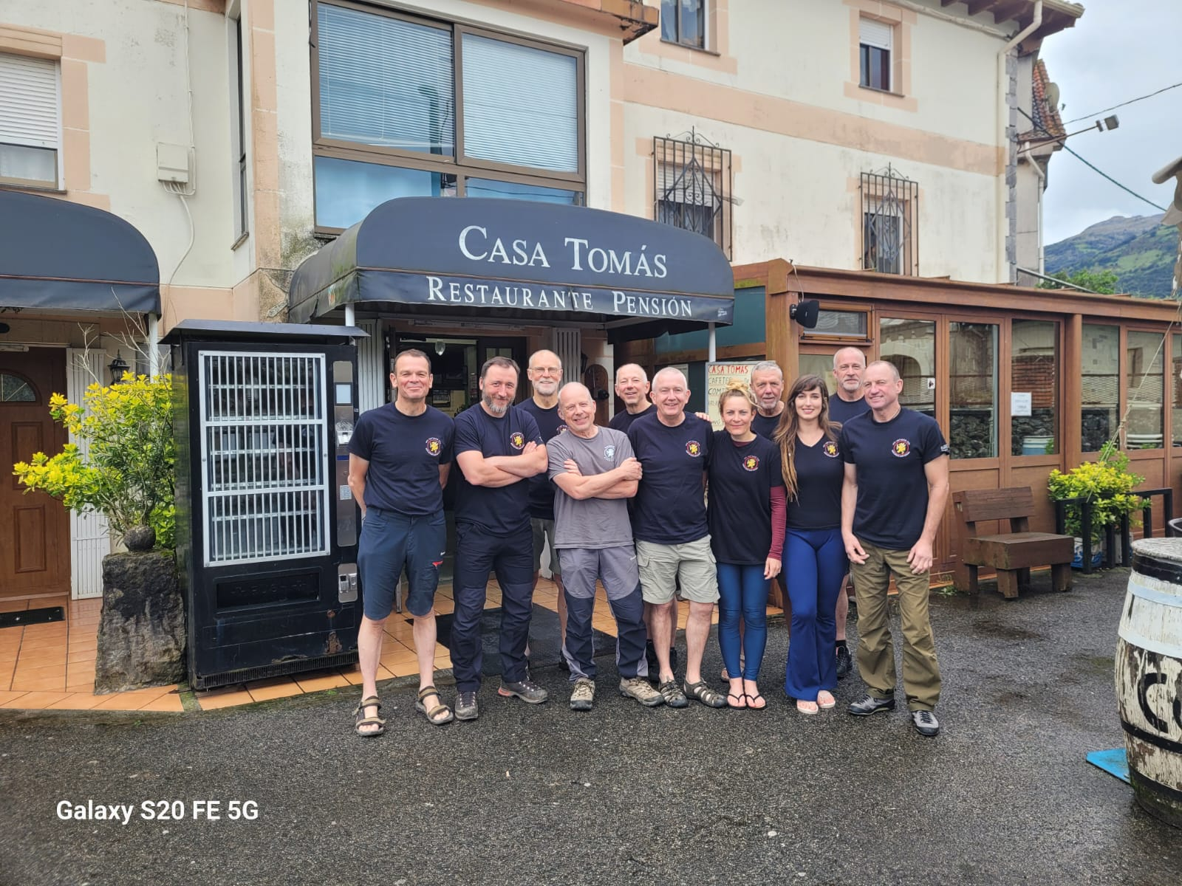
Cantabria 2026 T-shirt
Order form:
https://docs.google.com/forms/d/e/1FAIpQLSecVqQ7s2x8ia164AFjnjCRreP1HMura6p-Fkgtnng7mtYDfA/viewform?usp=dialog

Slide 28
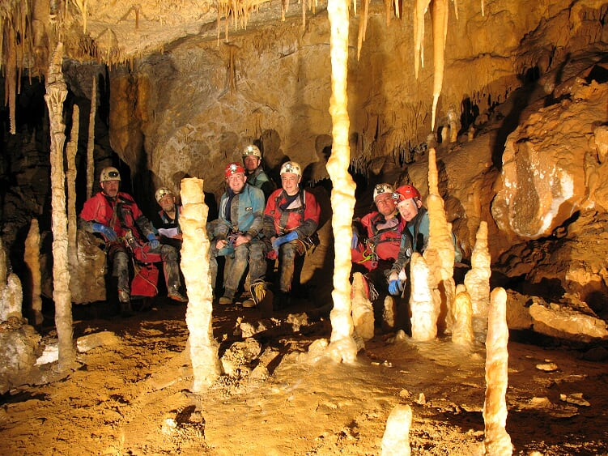
What’s next?

Slide 29
What’s next?
Travel form:
Travel & Accomodation.xlsx
Insurance information form: https://docs.google.com/forms/d/e/1FAIpQLSfbOi_eaEywWvhIUDXAWnoJldSUg9KcfoDQgZ6T2WhZNXeVyg/viewform?usp=sharing&ouid=108519175096752440361
Caving equipment fee:
£20 payable to WCC, REF: NAMECAE
Training:
Yorkshire May bank holiday (Gaping gill winch meet)
Pull through technique (TBC)
Cantabria T-shirt order form:
https://docs.google.com/forms/d/e/1FAIpQLSecVqQ7s2x8ia164AFjnjCRreP1HMura6p-Fkgtnng7mtYDfA/viewform?usp=dialog

